Slide 1
House Price Prediction Using ML
Rohan Kumar Meher(17ECE022)
Uma Maheswar Panda(17ECE030)
Jiteswar Meher(17ECE025)

Slide 2
Objective
Predict the house price
Using two different models in terms of minimizing the difference between predicted and actual rating

Slide 3
Methodologies used
Machine learning
Python

Slide 4
The following features we provided:-
Date: Date house was sold ✔️Price: Price is prediction target ✔️Bedrooms: Number of Bedrooms/House ✔️Bathrooms: Number of bathrooms/House ✔️Sqft_Living: square footage of the home ✔️Sqft_Lot: square footage of the lot ✔️Floors: Total floors (levels) in house ✔️Waterfront: House which has a view to a waterfront ✔️View: Has been viewed ✔️Condition: How good the condition is ( Overall ) ✔️Grade: grade given to the housing unit, based on King County grading system ✔️Sqft_Above: square footage of house apart from basement ✔️Sqft_Basement: square footage of the basement ✔️Yr_Built: Built Year ✔️Yr_Renovated: Year when house was renovated ✔️Zipcode: Zip ✔️Lat: Latitude coordinate ✔️Long: Longitude coordinate ✔️Sqft_Living15: Living room area in 2015(implies — some renovations) ✔️Sqft_Lot15: lotSize area in 2015(implies — some renovations)

Slide 5
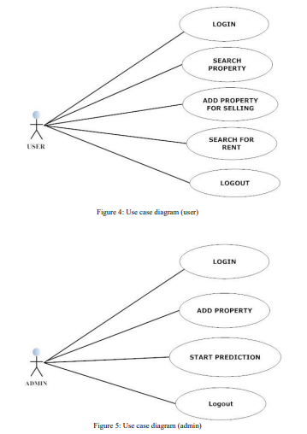

Slide 6
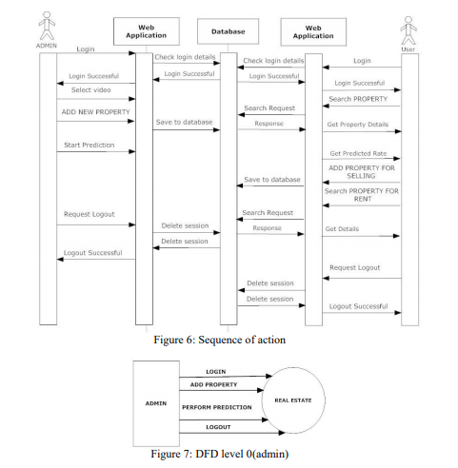

Slide 7
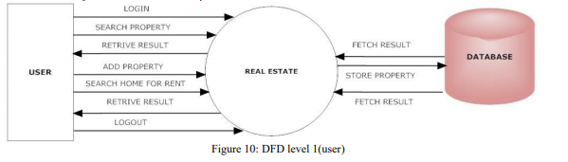

Slide 8
Thank you

